Slide 1



AI-Driven Stock Market Predictor with
Sentiment Analysis
FYP Proposal
Syed Muzammil Ahmed | (3014-2022)
Muhammad Wasif Sajjad | (2672-2022)
Ghufran-E-Azam | (2536-2022)
Supervisor Mr. Taha Shabbir Co-Supervisor Mr. Maaz Ahmed
Hamdard University

Slide 2
Outline
Group Introduction
Problem Statement
Project Objectives
Project Scope
Comprehensive Literature Review
Architectural Big Picture
Methodology
Role & Responsibility
Project Milestones
Project Plan (Time lines)
Project Tools
Project Deliverables
References

Slide 3
Group Introduction
Group Members:
Syed Muzammil Ahmed (3014-2022)
Muhammad Wasif Sajjad (2672-2022)
Ghufran-E-Azam (2536-2022)
Supervisor: Taha Shabbir
Why Selected?: Expertise in AI, machine learning, and data science, with experience in supervising projects involving predictive modeling and sentiment analysis.
Relevant Experience: Extensive knowledge in deep learning and NLP, ensuring valuable guidance for integrating sentiment analysis with stock market prediction.
Co-Supervisor: Maaz Ahmed
Supports project oversight and technical mentorship.

Slide 4
Problem Statement
Forecasting stock prices on the Pakistan Stock Exchange (PSX) is challenging due to high market volatility, economic uncertainty, and price swings influenced by investor sentiment. Traditional models mostly use historical price and volume data but often miss the impact of real-time news and market mood, reducing accuracy. Research shows that combining quantitative data with sentiment analysis from news or social media could improve predictions, but such integrated approaches are still not common for PSX (Khan et al., 2023; Raza et al., 2025). This gap highlights the need for hybrid models that capture both numerical trends and investor psychology to enhance forecasting performance in Pakistan’s volatile market.

Slide 5
Project Objectives
Develop a hybrid predictive model that combines financial time-series data with sentiment analysis to forecast HBL stock prices on the PSX.
Utilize FinBERT and the Loughran-McDonald financial sentiment dictionary to extract accurate domain-specific sentiment from local news sources.
Employ LSTM neural networks to model sequential dependencies and capture stock movement trends effectively.
Achieve and validate prediction accuracy between 85–90% using evaluation metrics such as RMSE, MAPE, and directional accuracy.
Build a scalable and ethically responsible framework suitable for future academic research and practical financial analysis.

Slide 6
Project Scope
Project Scope:
Predict daily HBL stock prices on PSX (Jan 2020–Jul 2025).
Use OHLCV data (yfinance) and sentiment from local news (Dawn, Business Recorder).
Target 85–90% accuracy with RMSE, MAPE, and directional accuracy.
Focus on HBL for manageable complexity; scalable to other PSX stocks and real-time data.
Ensure ethical, transparent sentiment analysis.
.
.

Slide 7
Comprehensive Literature Review
Comprehensive Literature Review
Traditional Models: ARIMA, SVMs are limited in handling nonlinearity and market sentiment (Box & Jenkins, 1976; Vapnik, 1995).
Deep Learning: LSTM networks outperform other models in time-series stock prediction by modeling long-term dependencies (Hochreiter & Schmidhuber, 1997).
Sentiment Integration: NLP tools like FinBERT and Loughran-McDonald dictionary enhance forecasting by capturing investor sentiment (Araci, 2019; Deveikyte et al., 2022).
Emerging Market Context: PSX's unique socio-political environment benefits from localized sentiment modeling (Haroon et al., 2023; Khan & Shaikh, 2024).

Slide 8
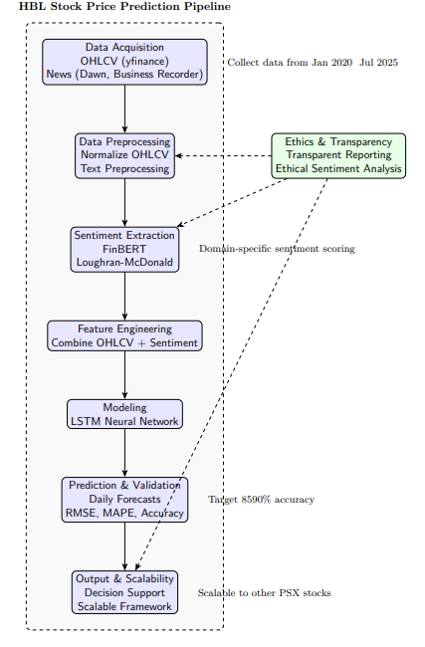
Architecture Big Picture

Slide 9
Project Methodology
Research Framework and Methodology
Development Framework: Utilize Agile methodology for iterative and incremental development, promoting adaptability and continuous improvement (Highsmith, 2009).
Data Collection:
Stock Data: Acquire OHLCV historical data for HBL from the yfinance API.
News Sentiment: Gather financial news via RSS feeds and web scraping from reputable local sources such as Dawn and Business Recorder.
Sentiment Analysis:
Implement FinBERT, a domain-specific transformer-based model, for sentiment classification of financial news texts (Araci, 2019).
Complement sentiment scoring with the Loughran-McDonald financial dictionary to enhance domain relevance and accuracy (Loughran & McDonald, 2011).

Slide 10
Project Methodology
Modeling Approach:
Apply Long Short-Term Memory (LSTM) neural networks combined with an attention mechanism to capture sequential dependencies and focus on critical time-series features relevant to stock price movements (Hochreiter & Schmidhuber, 1997; Fischer & Krauss, 2018).
Evaluation Metrics:
Measure predictive performance using:
Root Mean Squared Error (RMSE) with target <5%
Mean Absolute Percentage Error (MAPE) with target <10%
Directional Accuracy aiming for 85–90%.

Slide 11
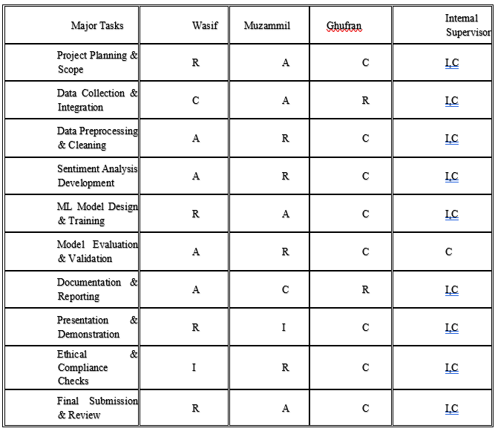
Project Role & Responsibilities
Task | Wasif | Muzammil | Ghufran
Financial Data Collection | A | C | R
Sentiment Data Collection | A | R | C
Data Preprocessing & Cleaning | A | R | C
Sentiment Analysis Module | R | C | A
Stock Prediction Model | R | A | C
Model Evaluation & Testing | R | A | C
Visualization & Dashboard | R | C | A
Prototype Interface Development | A | R | C
Report Writing & Documentation | A | C | R
Presentation & Final Review | C | A | R

Slide 12
Project Milestones
Project Initialization : Defined problem statement, research objectives, and team roles. Finalized data sources and began initial literature review.
Data Collection : Collected historical OHLCV data for HBL from yfinance and gathered financial news articles from Dawn, Business Recorder, and The News.
Data Preprocessing : Normalized stock data and cleaned news text using tokenization, lemmatization, and stopword removal.
Sentiment Annotation : Applied FinBERT and Loughran-McDonald Dictionary to assign sentiment scores (positive/neutral/negative) to news articles.
Feature Engineering : Merged sentiment scores with stock data by date. Created lag features and structured dataset for model input.
Model Design : Designed LSTM model with attention mechanism. Finalized hyperparameters and evaluation metrics.

Slide 13
Project Milestones
Model Training : Trained and tuned the LSTM model using 5-fold cross-validation. Tracked performance via RMSE, MAPE, and directional accuracy.
Evaluation : Assessed model on test data. Conducted error analysis and validated prediction accuracy (target: 85–90%).
Research Validation : Compared results with related studies. Performed statistical validation and finalized findings.
Report Writing : Drafted full FYP-II research report including all sections, visuals, and references.
Supervisor Review : Revised report based on supervisor feedback. Finalized formatting and citations.
Final Submission : Submitted report, prepared slides, and rehearsed presentation for defense.
FYP-II Evaluation : Presented findings to the evaluation panel, answered questions, and completed project defense.

Slide 14
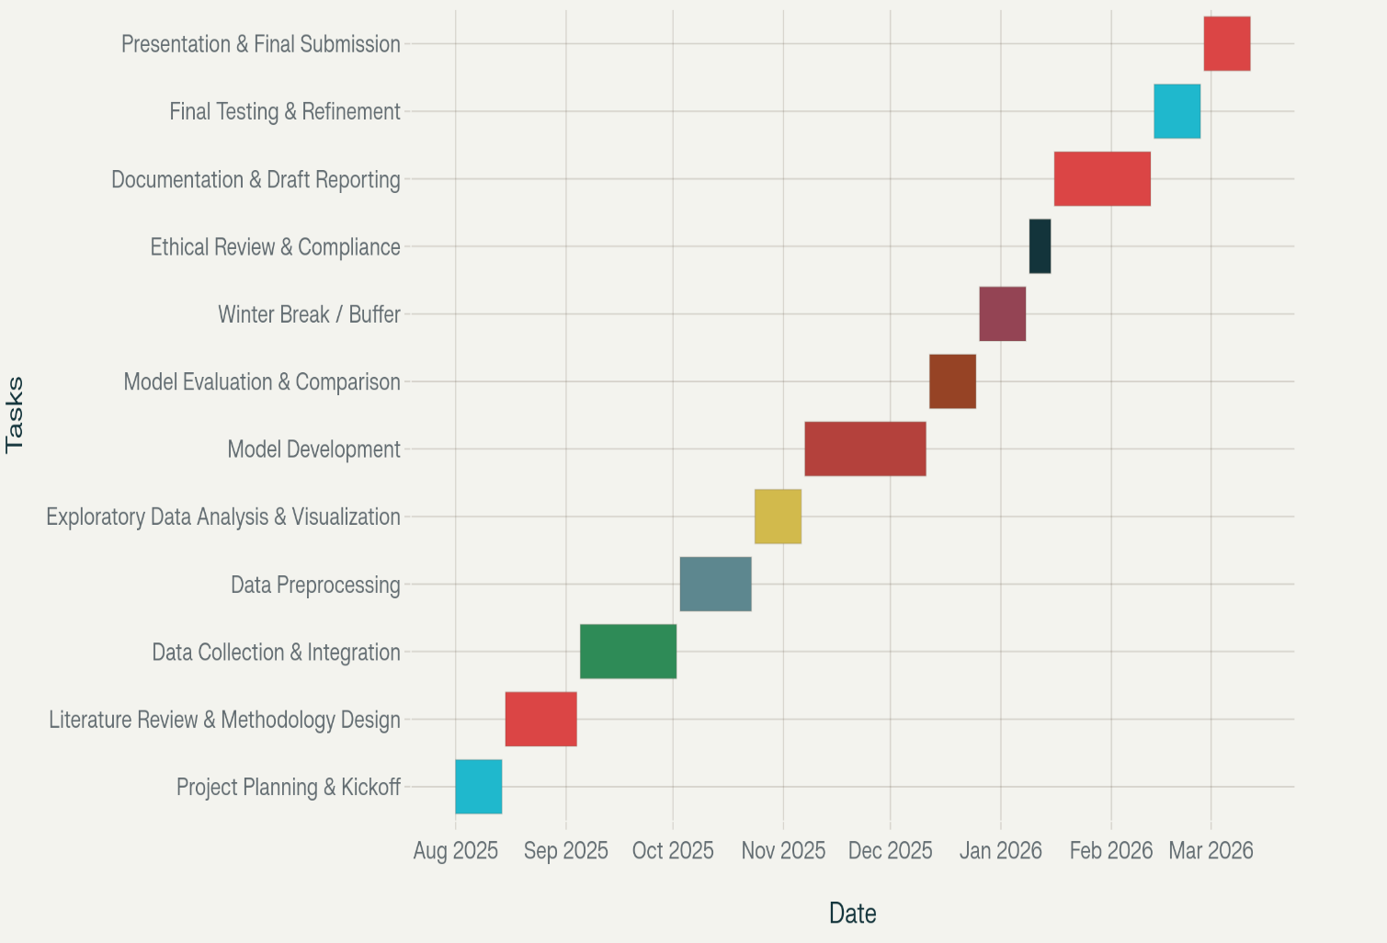
Project Plan

Slide 15
Project Tools
Category | Tools Used
Programming | Python, Jupyter Notebook
Data Handling | Pandas, NumPy
Deep Learning | TensorFlow, Keras (LSTM, BiLSTM)
NLP & Sentiment | FinBERT, Loughran-McDonald Dictionary
Visualization | Matplotlib, Seaborn
Data Access | yfinance, RSS scraping (Dawn, BR, News)

Slide 16
Deliverables
Project Deliverables
Cleaned and validated HBL OHLCV dataset
Labeled and scored sentiment corpus
Trained LSTM model with combined feature input
Research paper with citations and evaluation metrics
Presentation & poster for FYP-II defense
Scalable prototype for future PSX stocks

Slide 17
References
Araci, D. (2019). FinBERT: Financial Sentiment Analysis with Pre-trained Language Models. arXiv preprint arXiv:1908.10063.
Chopra, R., & Sharma, G. D. (2021). Application of Artificial Intelligence in Stock Market Forecasting. Journal of Risk and Financial Management, 14(2), 45.
Deveikyte, V., et al. (2022). Sentiment Analysis in Financial Markets: A Review. Journal of Financial Data Science.
Fischer, T., & Krauss, C. (2018). Deep learning with long short-term memory networks for financial market predictions. European Journal of Operational Research, 270(2), 654–669. https://doi.org/10.1016/j.ejor.2017.11.054
Haroon, O., et al. (2023). Localized sentiment analysis for emerging stock markets. Emerging Markets Journal.
Highsmith, J. (2009). Agile Project Management: Creating Innovative Products. Addison-Wesley.
Hochreiter, S., & Schmidhuber, J. (1997). Long short-term memory. Neural Computation, 9(8), 1735–1780.
Khan, M., Ahmed, S., & Tariq, R. (2023). Challenges in stock price prediction on Pakistan Stock Exchange. Journal of Emerging Financial Markets, 12(2), 45–59.

Slide 18
References
Khan, M., & Shaikh, S. (2024). Investor sentiment and stock market volatility in Pakistan. Pakistan Economic Review.
Loughran, T., & McDonald, B. (2011). When is a liability not a liability? Textual analysis, dictionaries, and 10-Ks. The Journal of Finance, 66(1), 35–65.
Mokhtari, S., Yen, K.K., & Liu, J. (2021). Effectiveness of Artificial Intelligence in Stock Market Prediction. arXiv preprint arXiv:2107.01031.
Raza, S., Qureshi, A., & Malik, F. (2025). Sentiment analysis integration for stock market forecasting: Evidence from PSX. Asian Journal of Financial Technology, 7(1), 22–34.
Shah, T., & Malik, J. (2024). Hybrid models for forecasting in emerging markets: Case of Habib Bank Limited. International Review of Finance and Economics, 19(3), 121–130.
Vapnik, V. (1995). The Nature of Statistical Learning Theory. Springer.

Slide 19
THANK YOU!

